Slide 1
Unit-3 Mathematics Fair
By- Dr. Meena Sharma

Slide 2
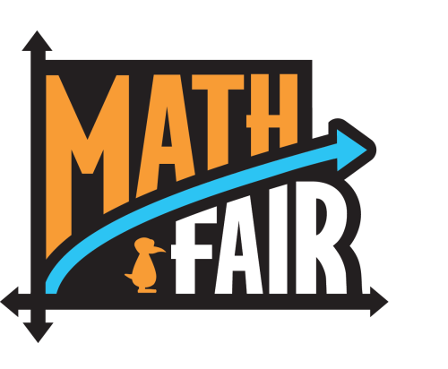
Mathematics fairs can help talent to surface and foster mathematical gifts in learners. They provide challenging opportunities to the gifted children. Exhibition helps students to express themselves through attractive models.

Slide 16
THANK YOU
STAY HOME
STAY SAFE

